Slide 1
Petivity
Medium-Fi Prototype

Slide 2



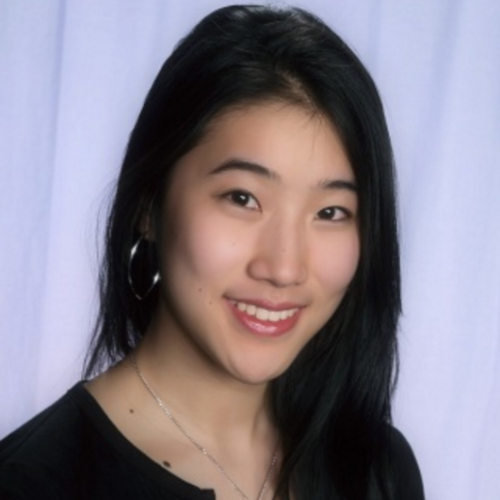
MEET THE TEAM
Ivan Salinas
Sidra Ijaz
Crystal Zheng
Jonathan Mao
Notes:
People often have a difficult time completing tasks because of distractions, poor time management, and/or unhealthy work-life balance.

Slide 3
1.
Value​ ​Prop,​ ​Problem​ ​and​ ​Solution​ ​Overview

Slide 4
Petivity
“Productivity’s Best Friend”
Problem: People often have a difficult time completing tasks because of distractions, poor time management, and/or unhealthy work-life balance.
Solution: We aim to increase productivity by effectively eliminating distractions and keeping people on track in a fun and engaging way.
Notes:
Productivtiy because most people can relate to it

Slide 5
tasks
Notes:
From Deborah we also came up with two of our strongest HMW

Slide 6
Web:
Task 1 (Simple): Look through the to-do list and complete one of the tasks. Now that you’ve completed a task, add the task “Laundry” (which should be completed within 2 days) to your to-do list.
Task 2 (Complex): Schedule blocking time for Sunday at 2:30PM. Enable buzzfeed to be blocked and add Tumblr to your list of blocked websites. Start blocking to see blocking effect.
Task 3 (Medium): Schedule one of Petivity’s self-care activity suggestions on the calendar.
Mobile:
Also addresses Task 2: begin blocking timer to start and end “Forest” app-like blocking mechanism, then interact with pet.

Slide 7
Changes:
For task 1, we revised the task so the user adds the same task as the one they checked off to the list so all of our Marvel screens will be consistent and reusable.
For task 2, we revised the wording because we no longer have two buttons for hard or soft block but one that blocks everything. Since we figured out the task flow for the scheduled block times calendar, we incorporated it in task 2.

Slide 8
3.
Revised interface design

Slide 9
3. A
Major changes

Slide 10
Design Change #1

Slide 11
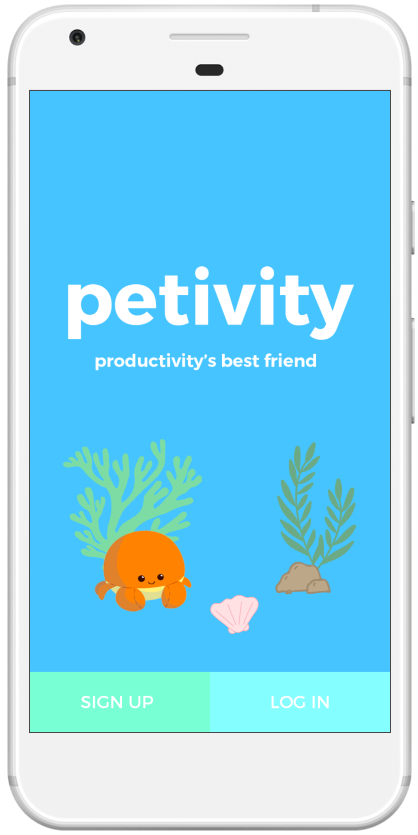
Created a mobile version to supplement the web application/chrome extension
A Mobile Application!
No Mobile Application
?

Slide 12
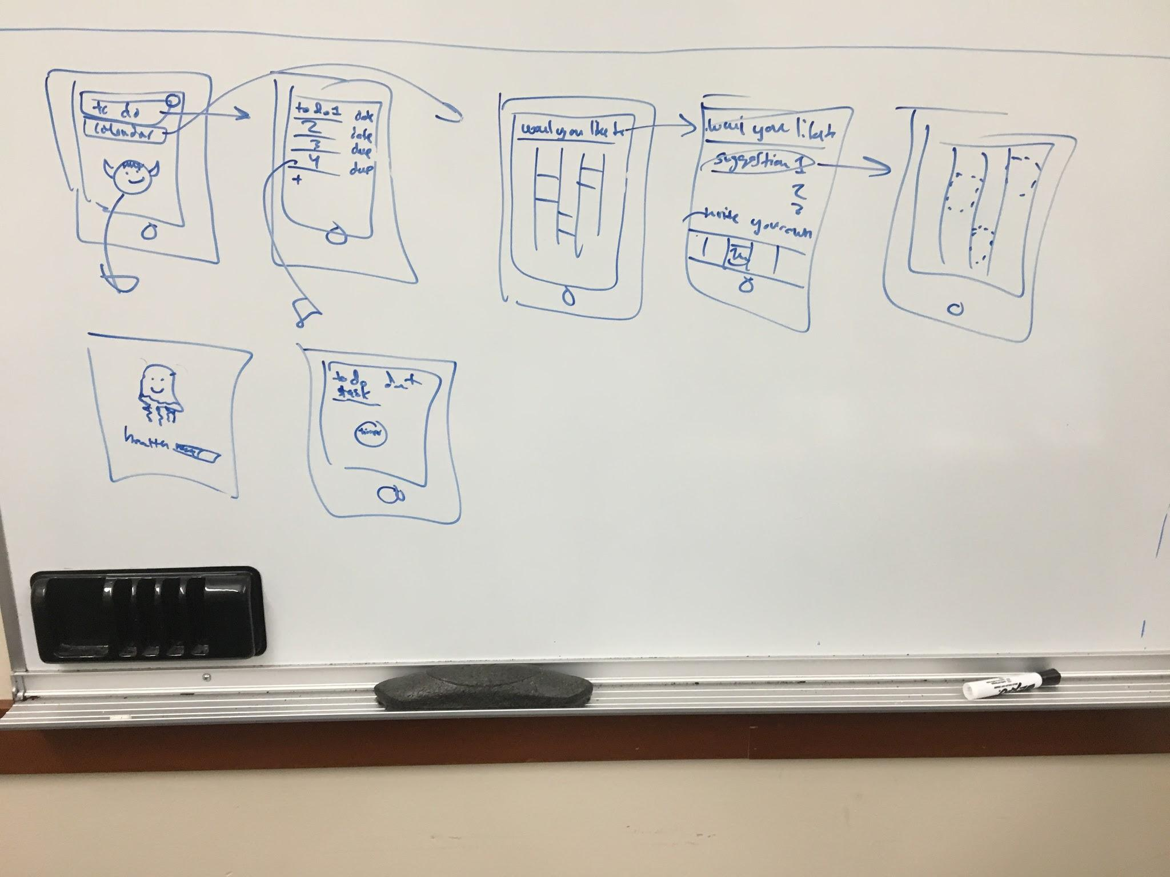
Before Sketch: Mobile
Notes:
Productivtiy because most people can relate to it

Slide 13
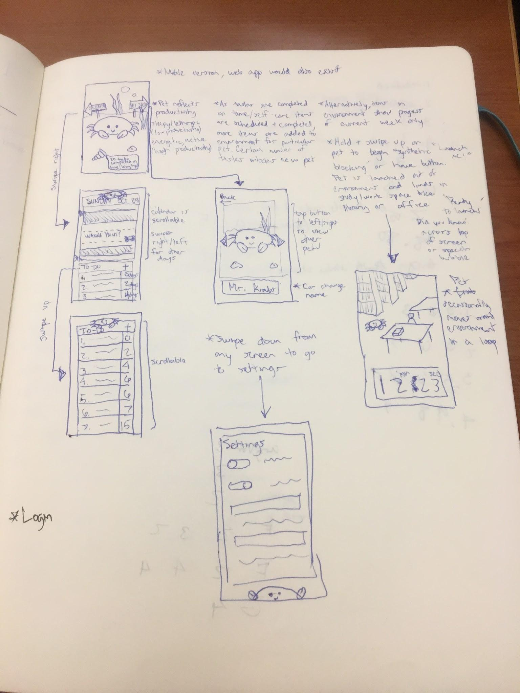
After Sketch: Mobile
Notes:
Productivtiy because most people can relate to it

Slide 14
Rationale:
We added a mobile component so our design became a hybrid Web-Mobile design because we were notified that all projects needed a mobile component. Thus, we pivoted from our original (solely web-based) application and received helpful advice from Landay and Kerry as to how to pivot from our original plans. The mobile component also further allows the user to have even more interactivity with the pet, which was emphasized in studio as something we should try to implement further.

Slide 15
Design Change #2 & #3

Slide 16
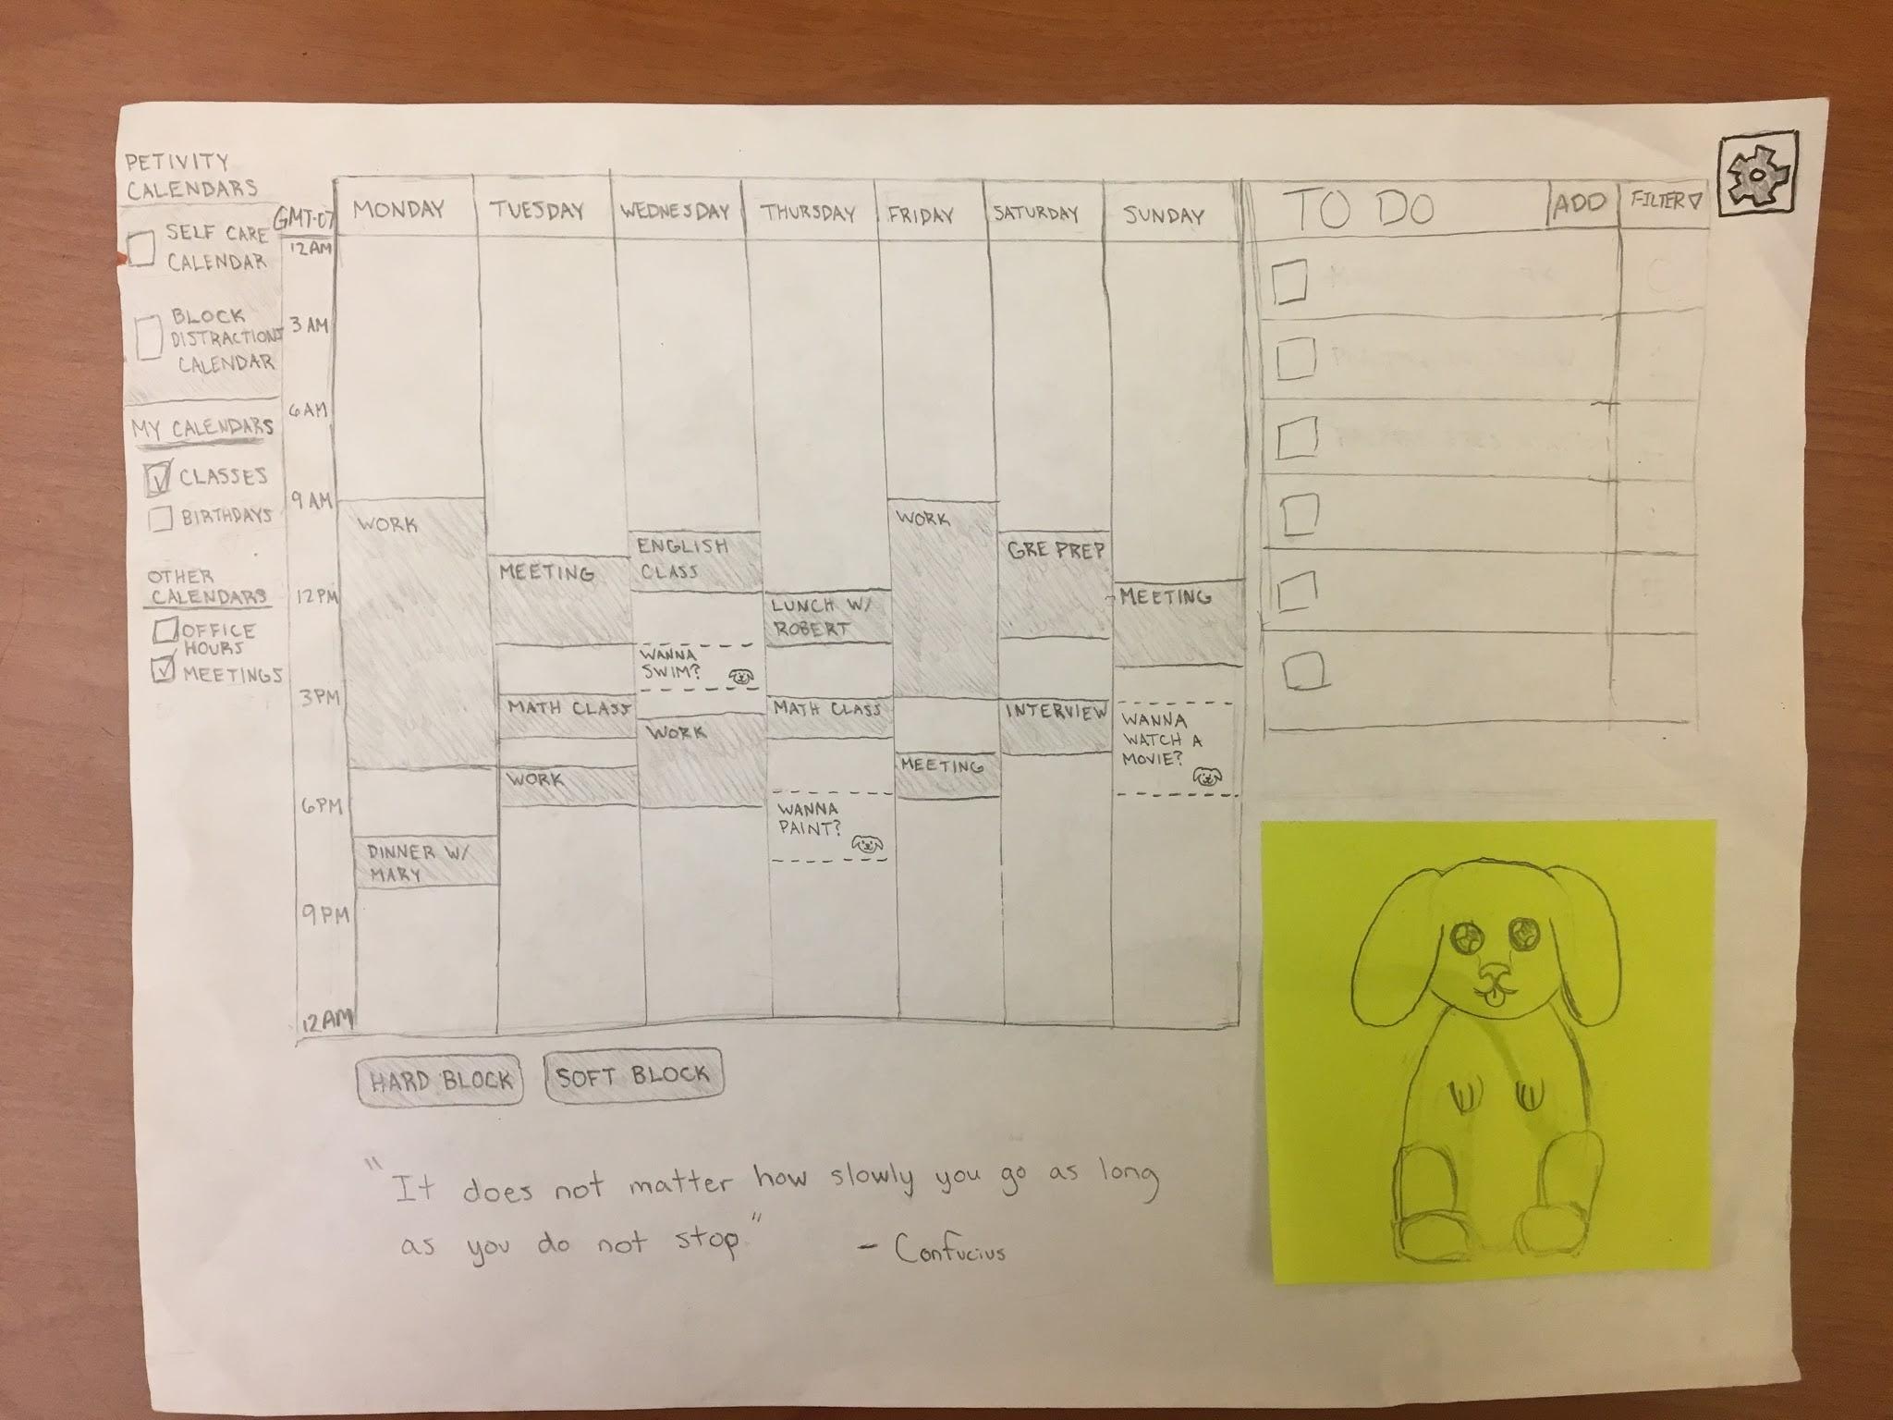
Before Sketch: Web

Slide 17
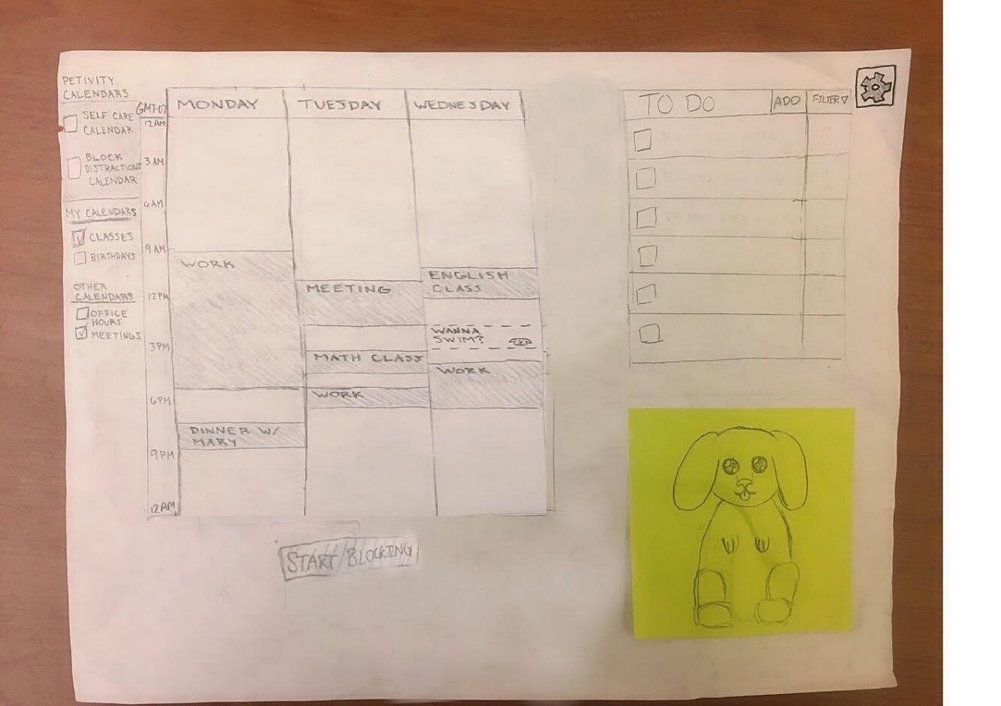
After Sketch: web
Made calendar only show three days

Slide 18
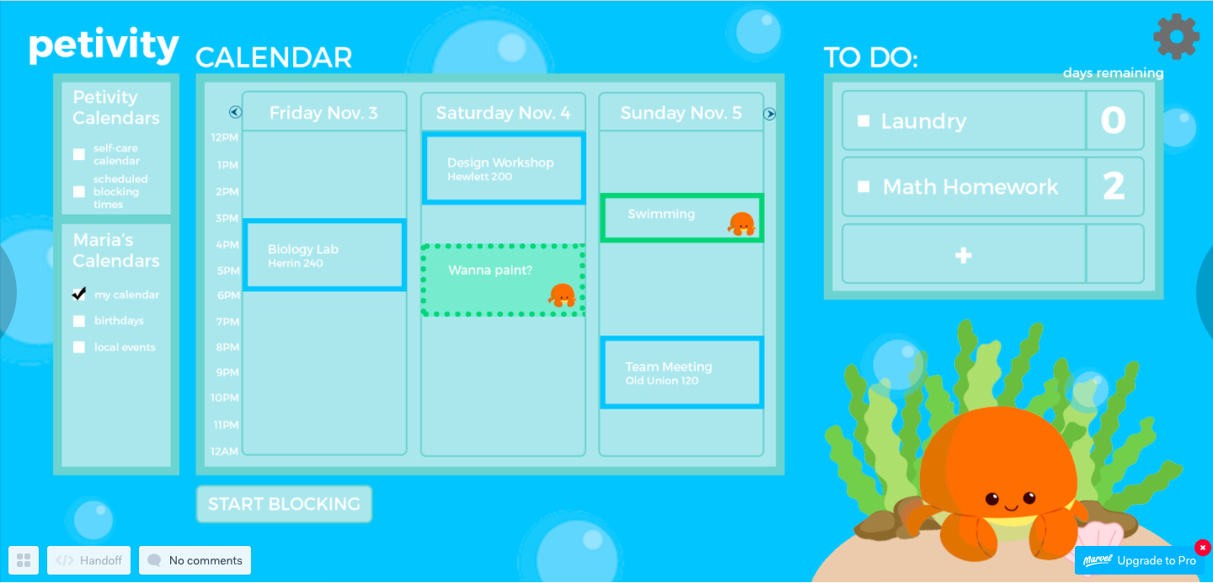
Web Prototype:

Slide 19
Rationale:
We changed it to a 3-day calendar because users expressed that it was hard to see the events and to discern the self-care events from the normal events. Furthermore, in studio, there was a mention of a 3-day calendar as a possible alternative. For our prototype, we made the font bigger and side calendars/main calendar more legible. By having a 3-day calendar, we were able to make the font size bigger and more legible and de-clutter the interface a bit.

Slide 20
After Sketch: web
Have only one button labeled “Start Blocking”

Slide 21
Rationale:
We changed the hard and soft block buttons to just one button that says “start blocking” because our users were confused with what “hard” and “soft” meant as well as why there were two buttons for blocking. So as of now, we are only implementing functionally the “hard” block, which aligns more closely with what users normally think of when a site is blocked.

Slide 22
3. b
TASK FLOWS

Slide 23
task #1 (Simple) flow
Notes:
Productivtiy because most people can relate to it

Slide 24
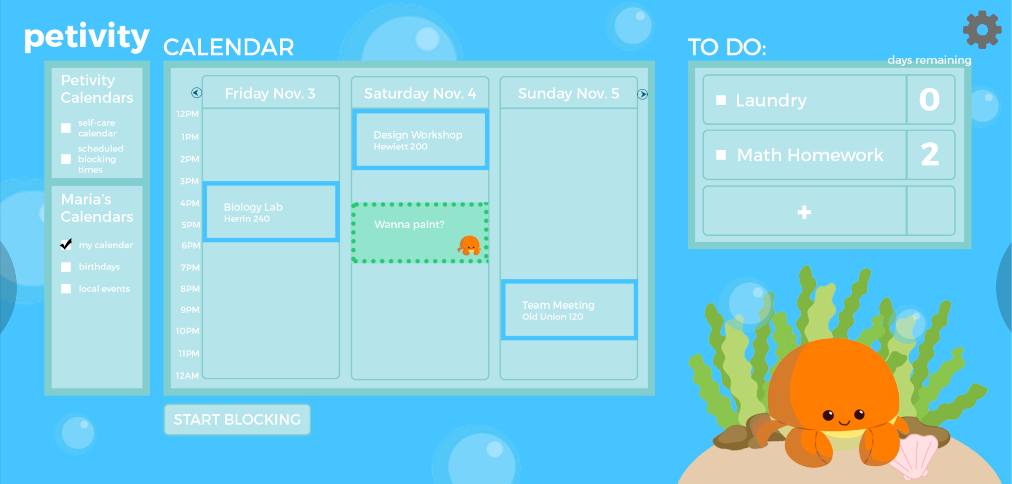
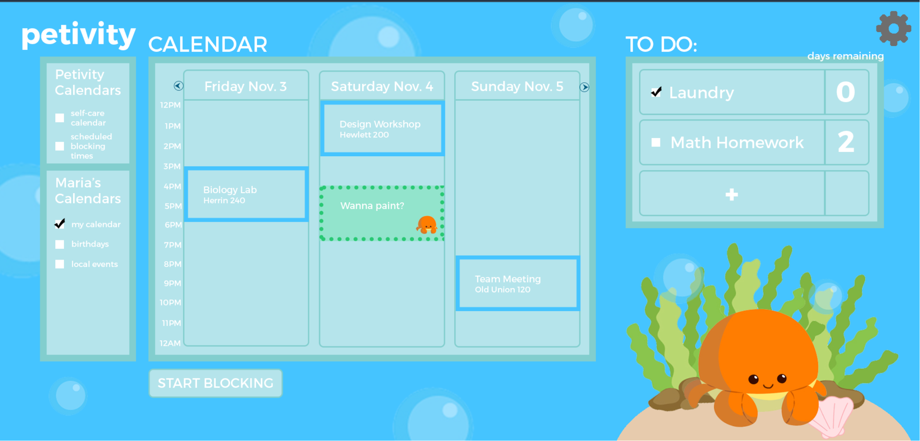
Check off Laundry to-do

Slide 25
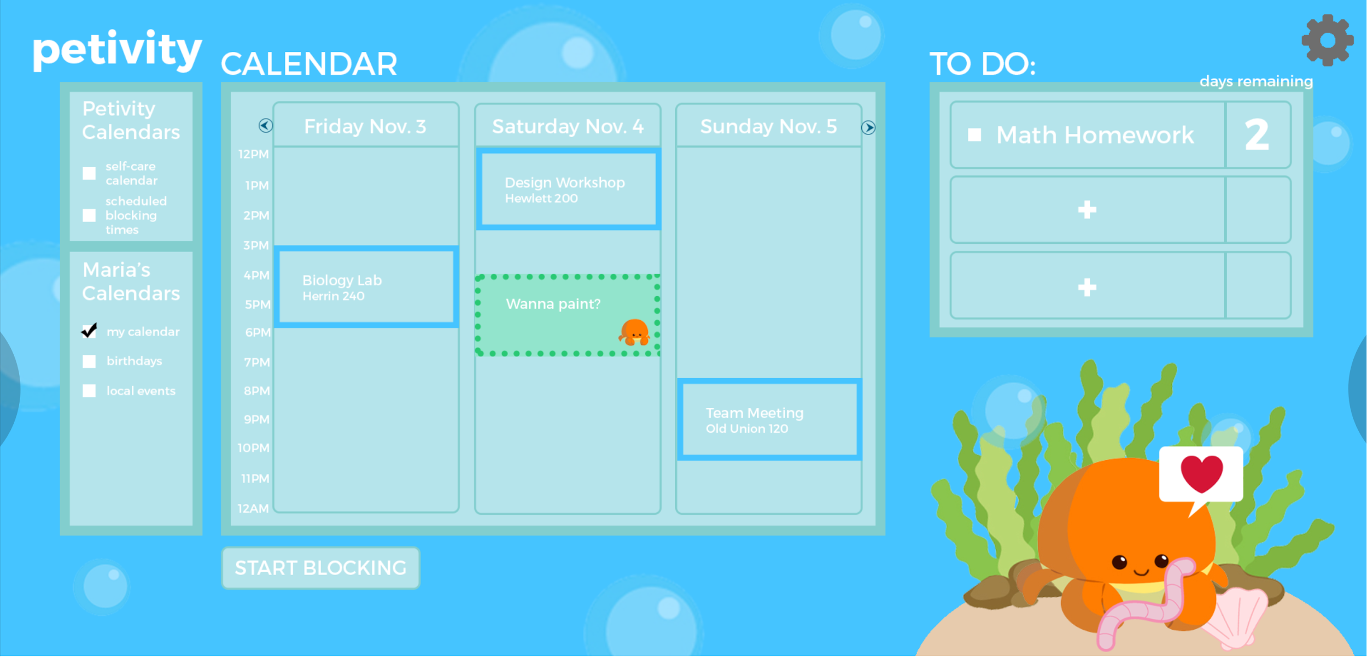
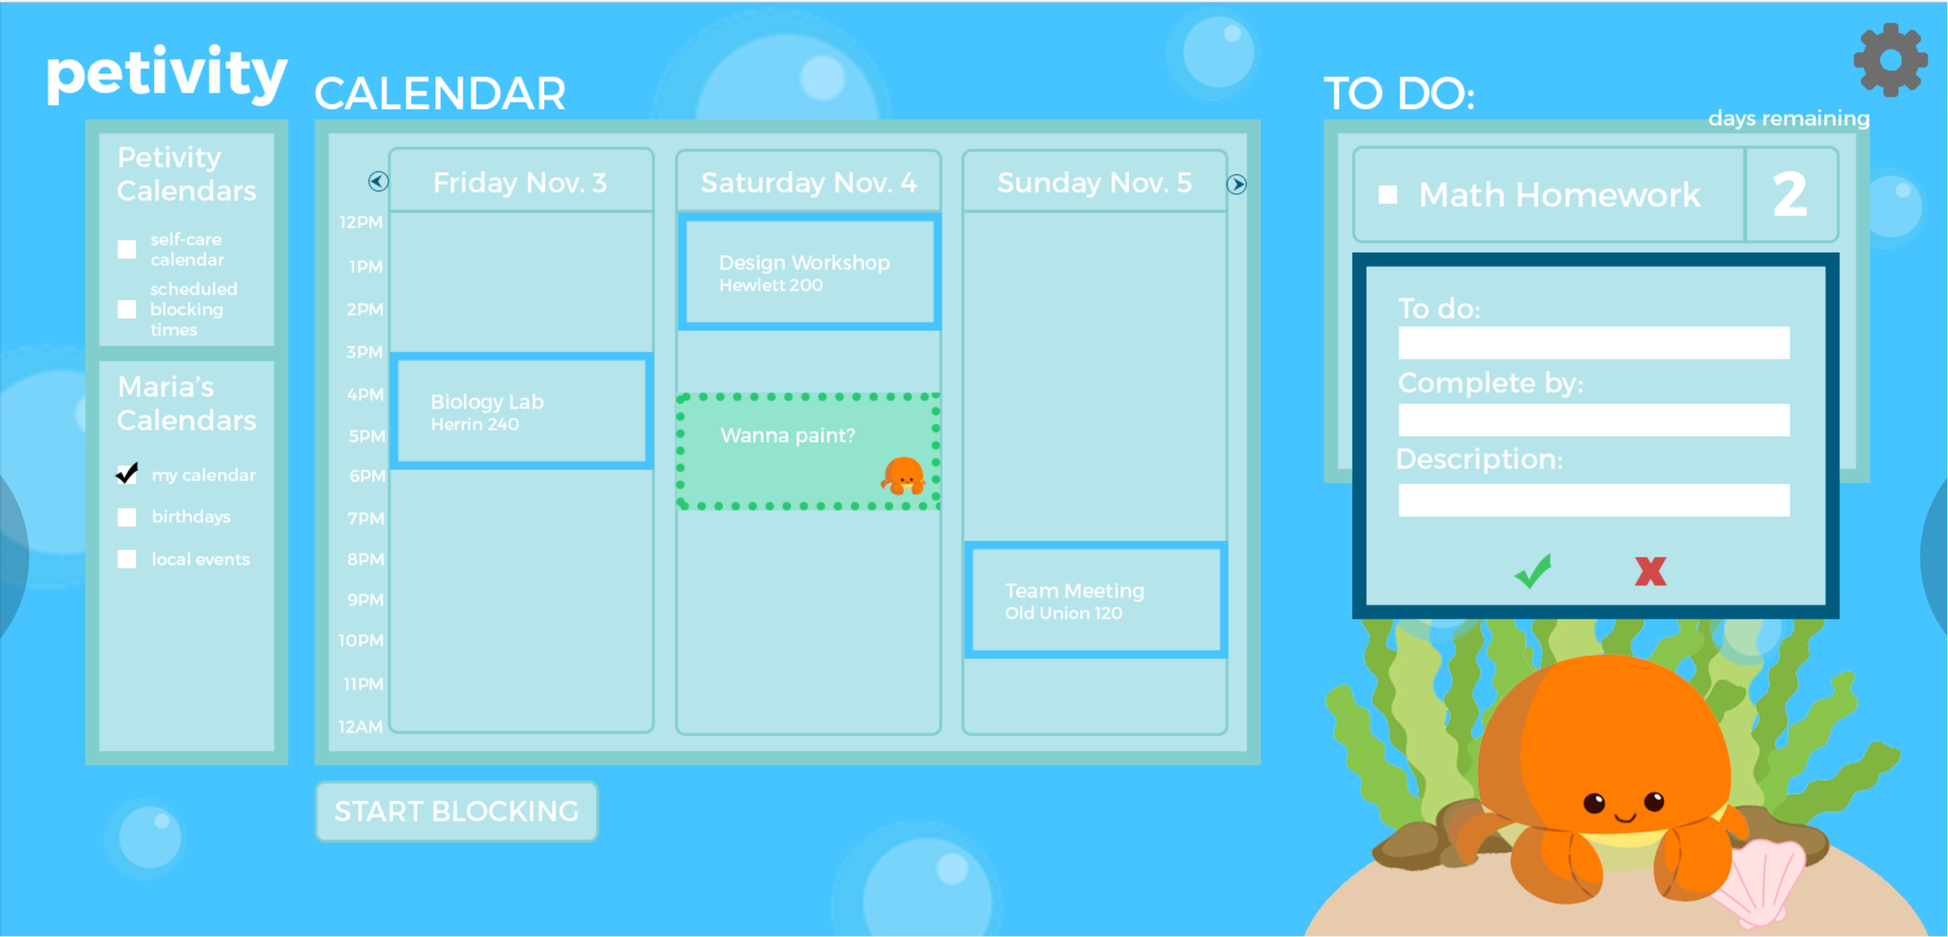
Click to add a new task

Slide 26

Fill out the task components and then click confirm
User is back at main page

Slide 27
task #2 flow (Complex): Web

Slide 28
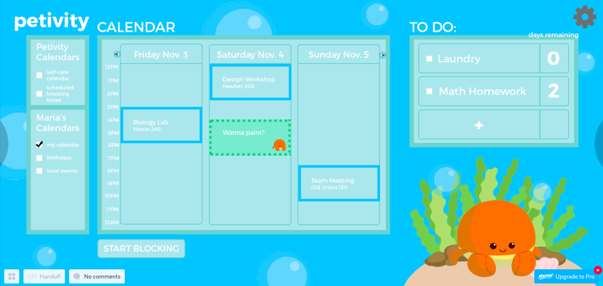
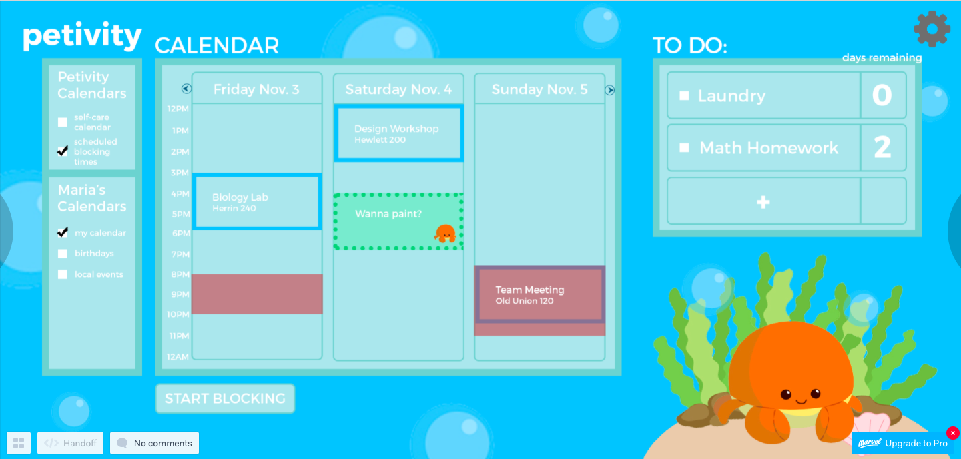
Main Page
Clicks on restart
Timer starts automatically
Click buttons to navigate
Click on scheduled blocking times
Click on page
Click approx. 2:30PM Sunday
Click on home
TASK 2: Web

Slide 29
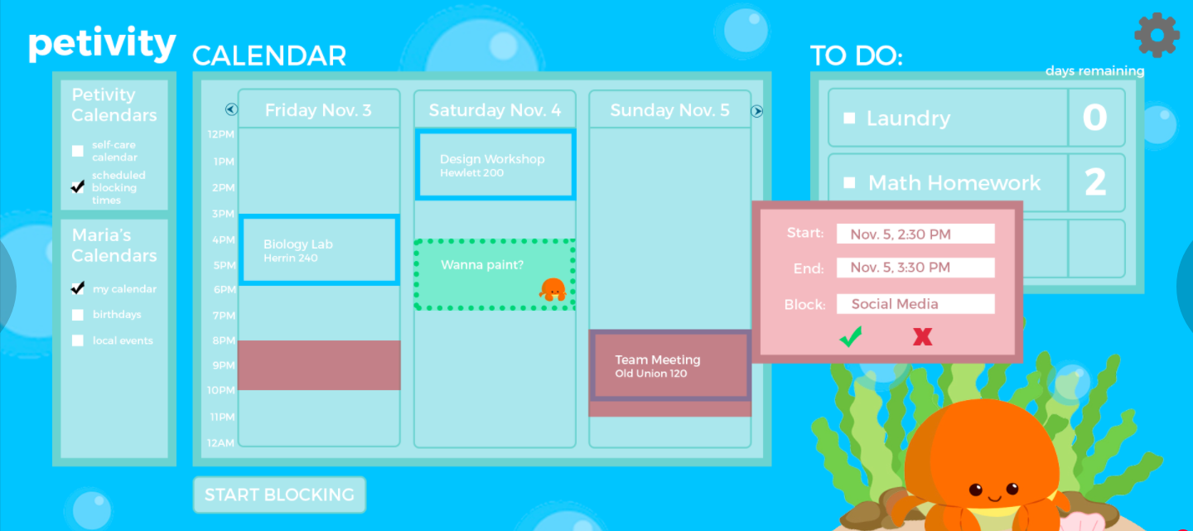
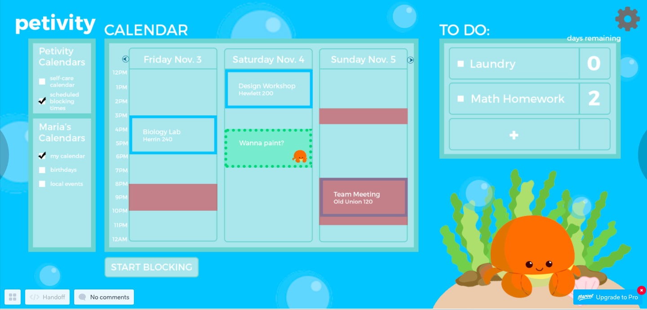
Click confirm
Timer starts automatically
Click buttons to navigate
Scheduled block time block appears in calendar
Click on page
Click to return to main
Click on home
Click on scheduled blocking times to go back to the main screen
TASK 2: Web

Slide 30
Timer starts automatically
Click buttons to navigate
Click on page
Click on home
User is back at main page
TASK 2: Web

Slide 31
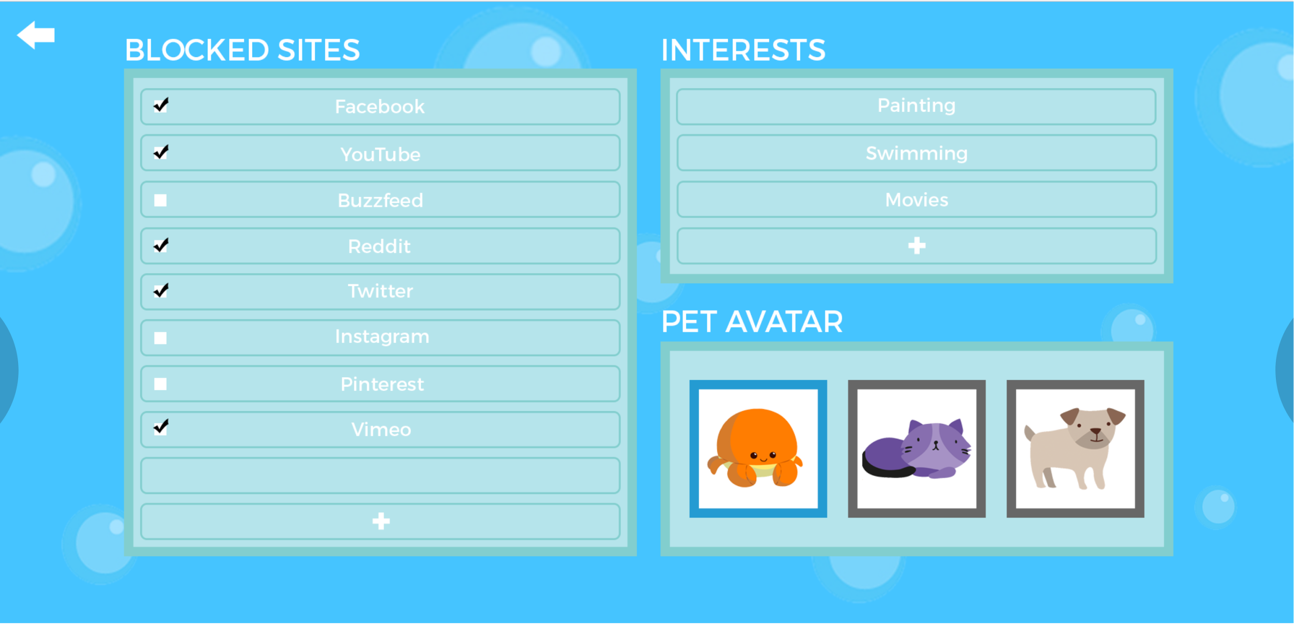
Go to Settings
Click to add Buzzfeed to your blocked sites list
TASK 2: Web

Slide 32
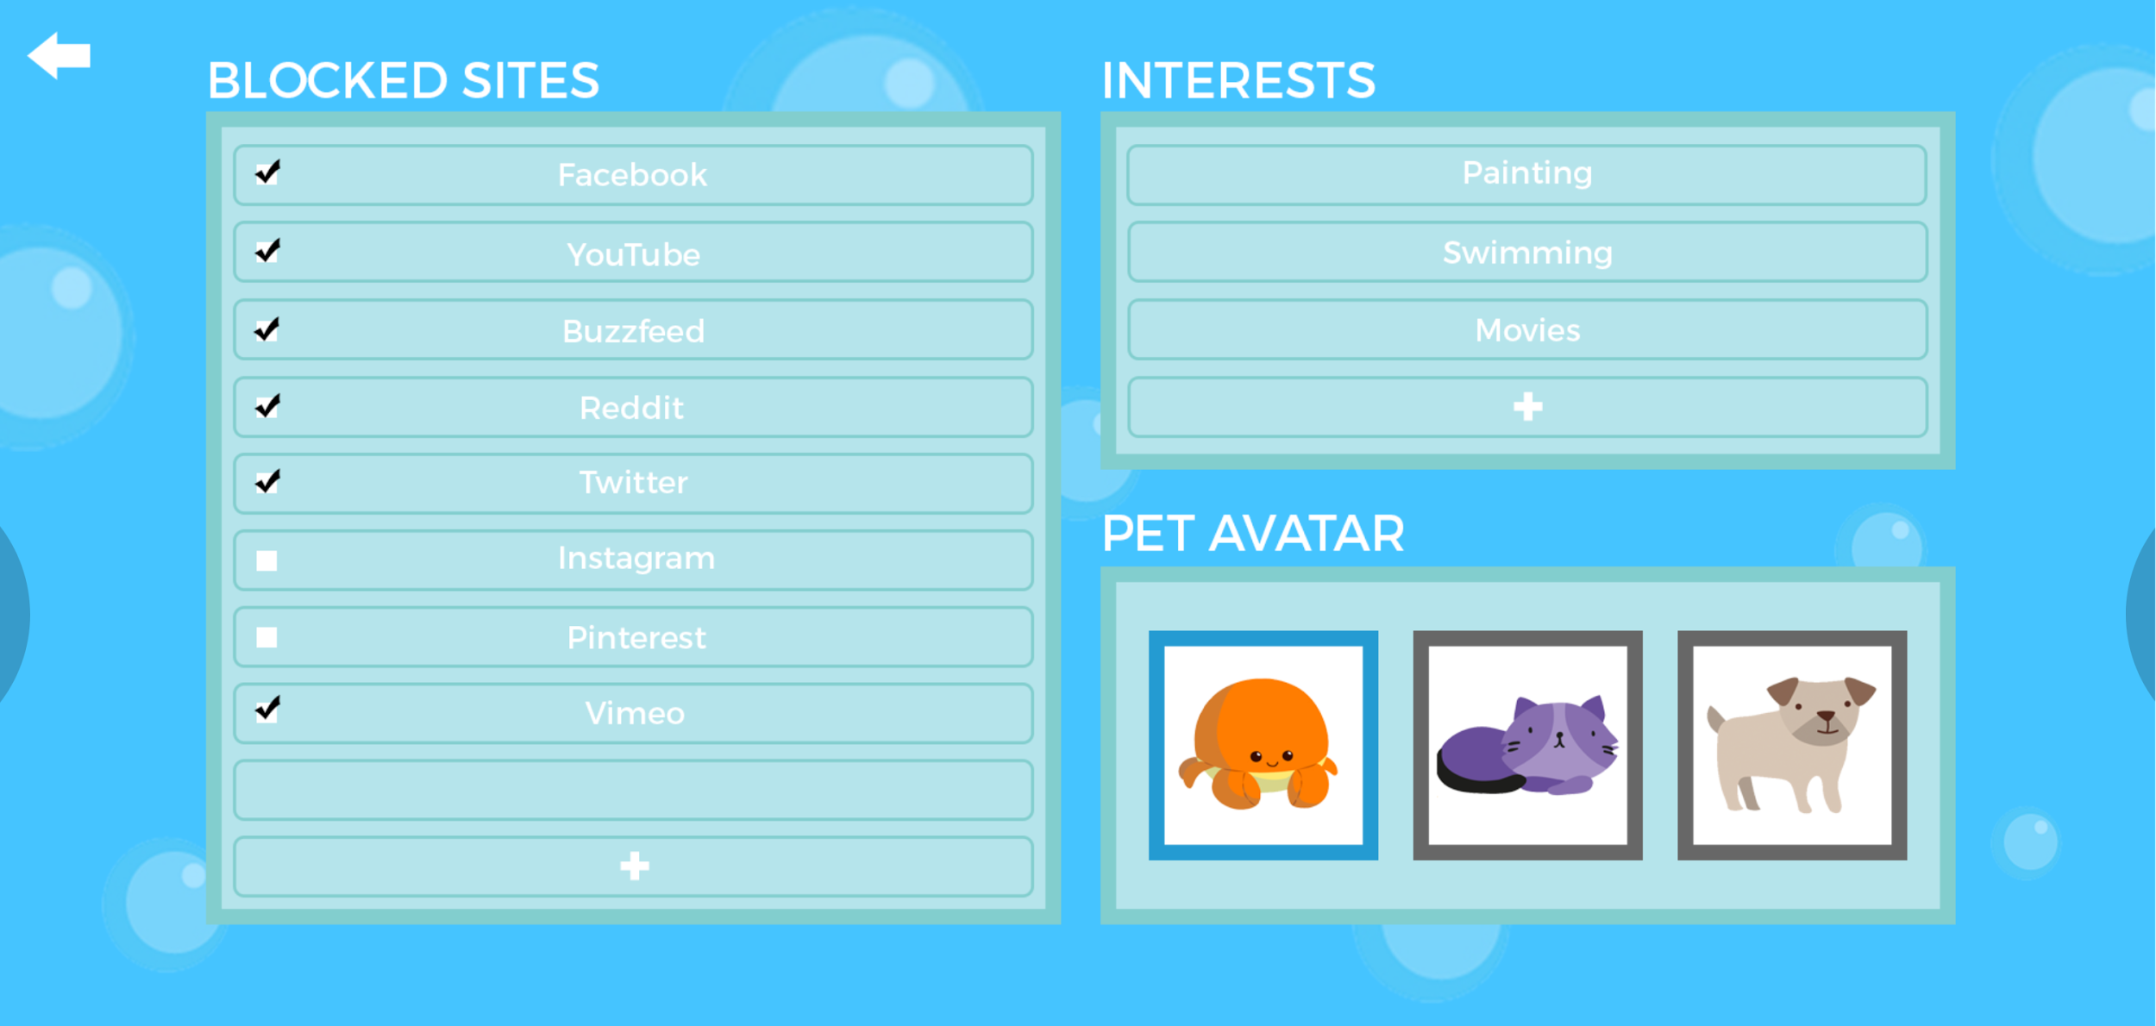
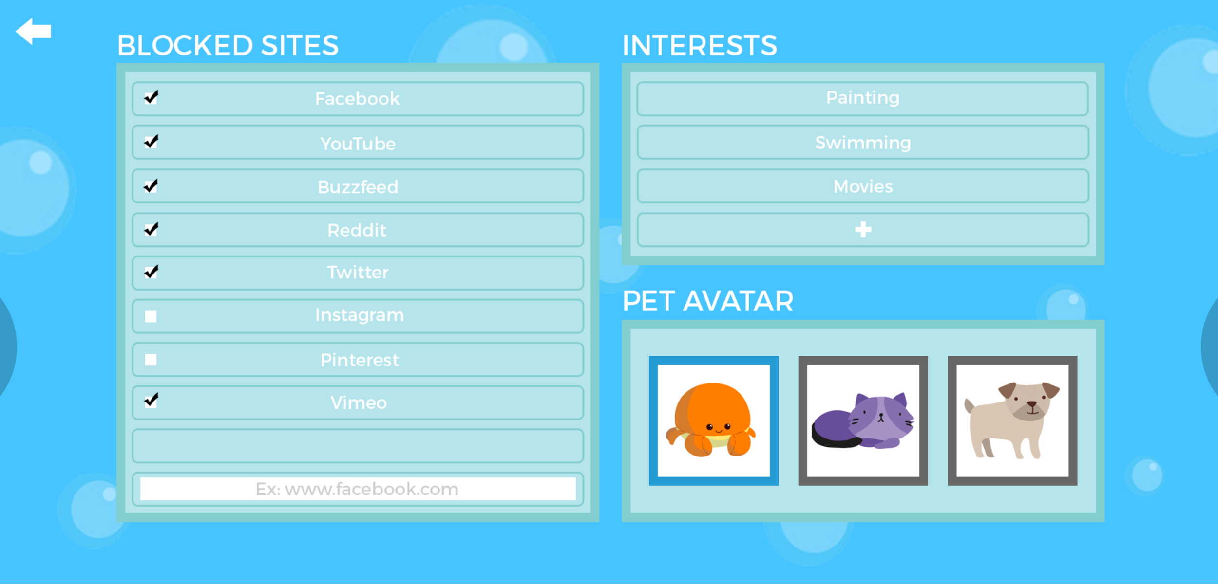
Blocking of Buzzfeed should be enabled now
Select to add a new website to block
TASK 2: Web

Slide 33
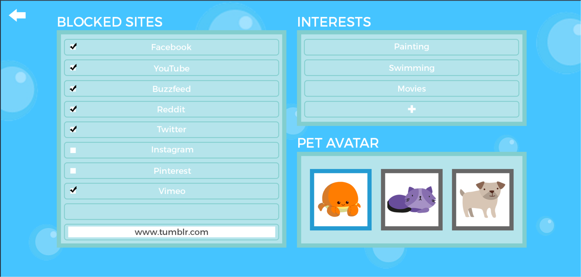
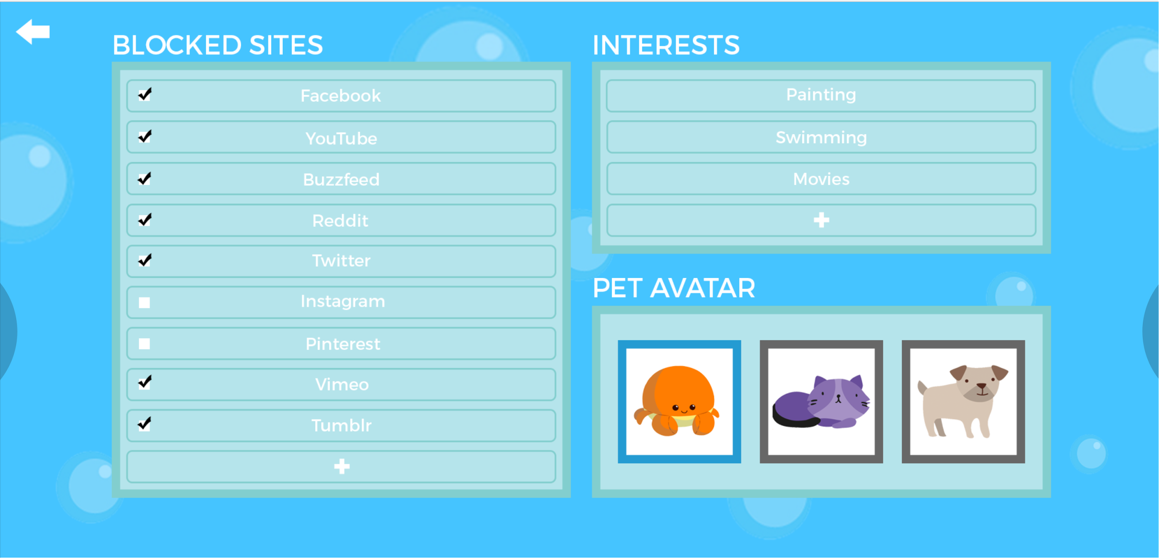
Type in new website (tumblr) to add it to the blocked sites list
TASK 2: Web

Slide 34
task #2 flow: Mobile

Slide 35
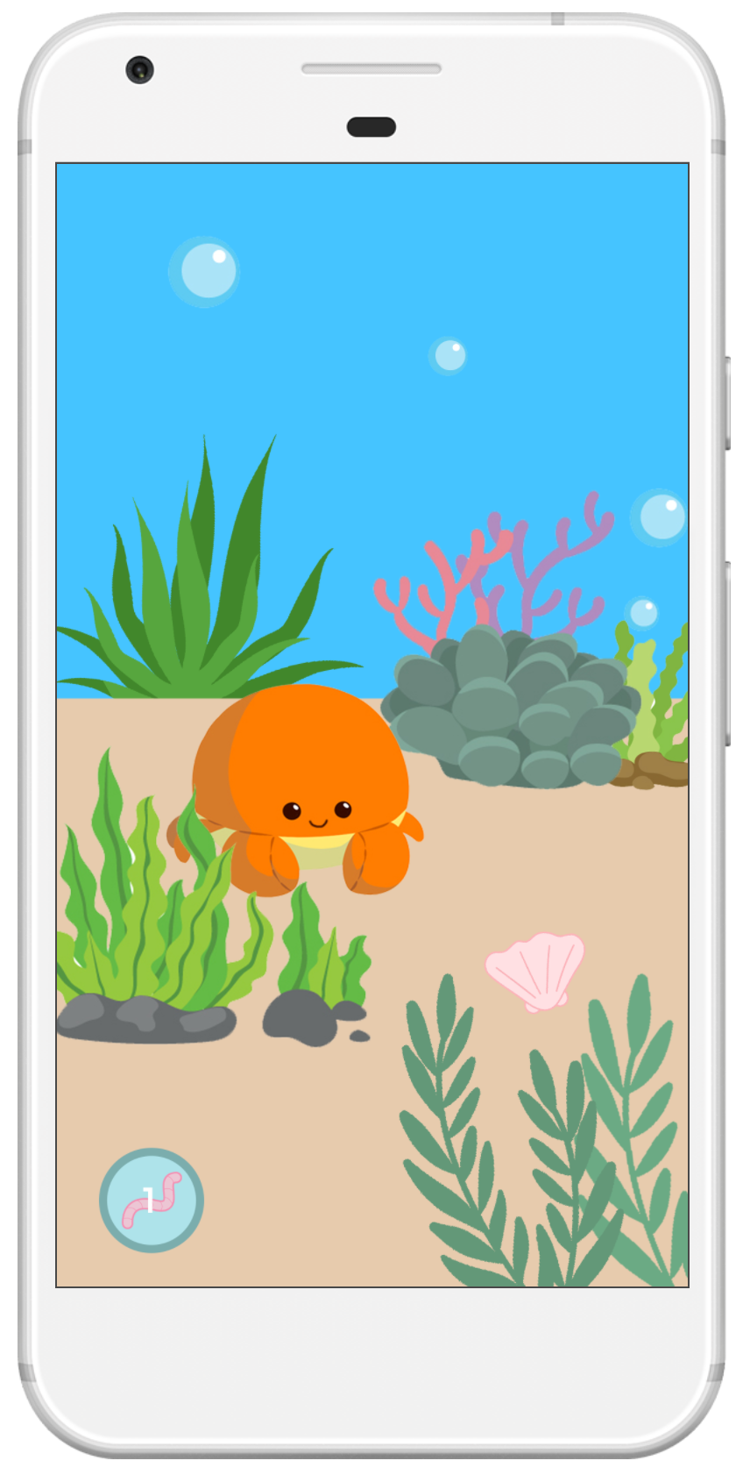
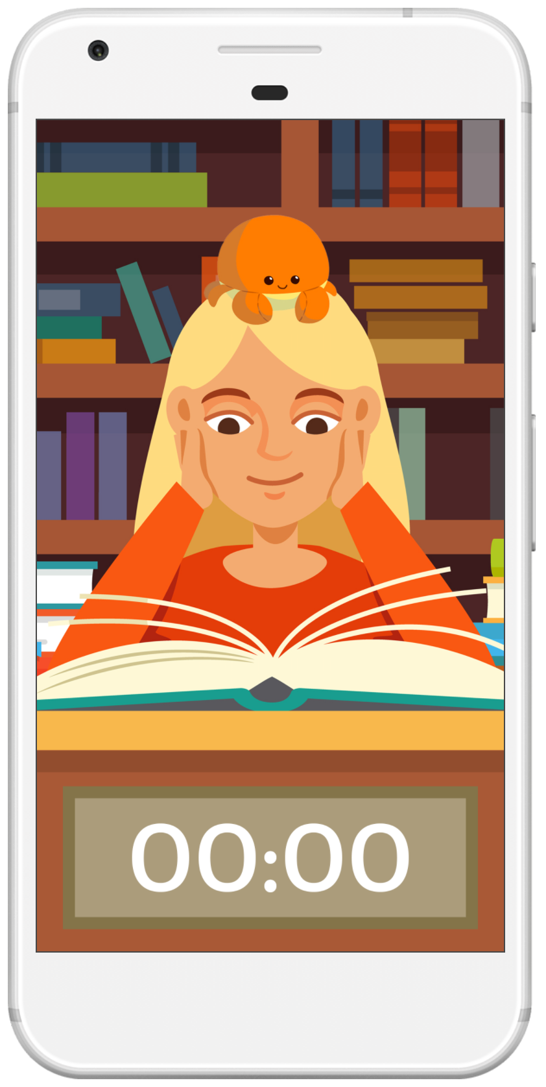
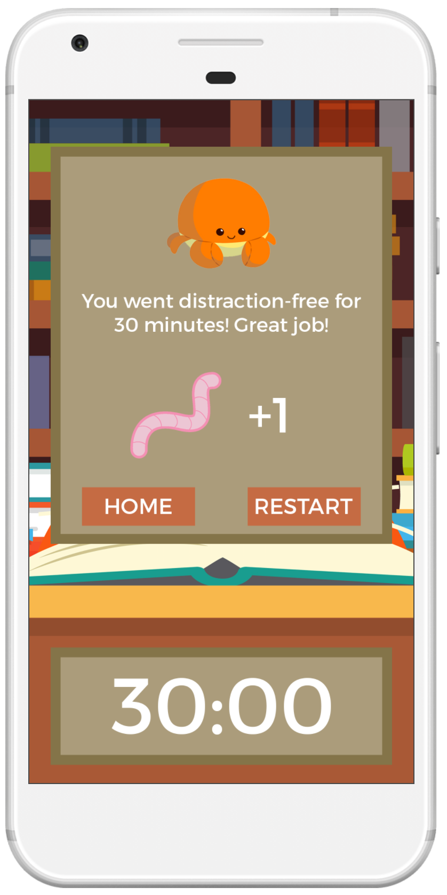
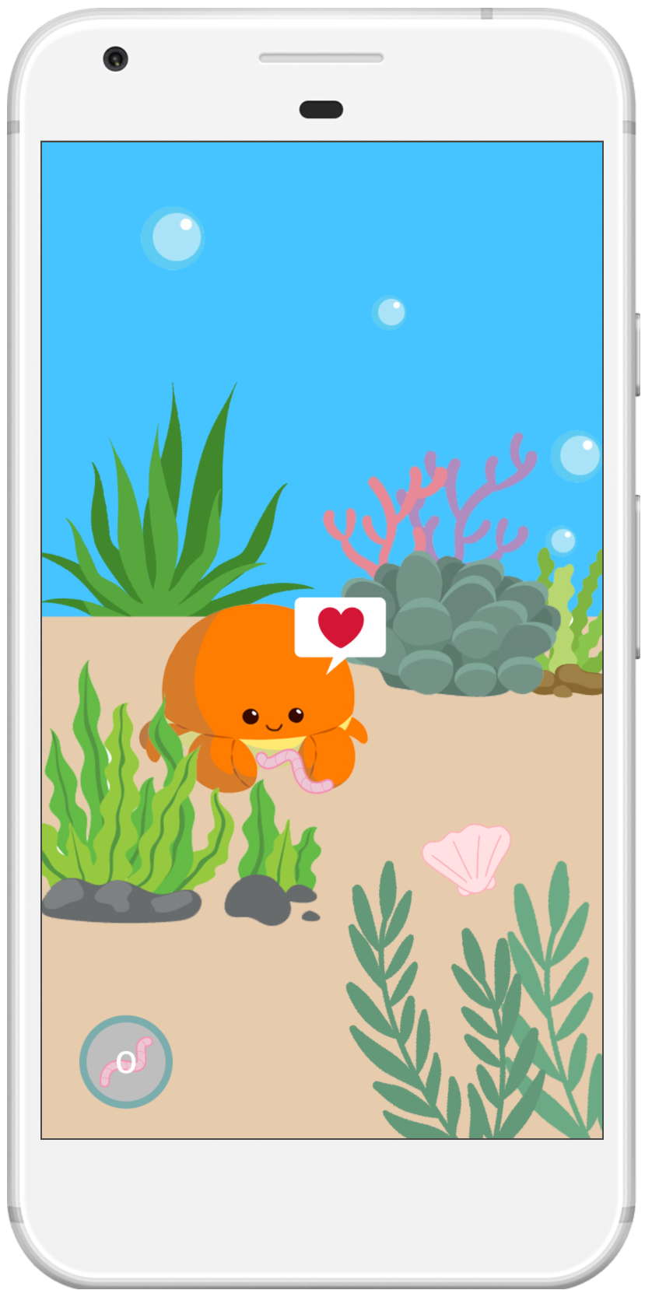
Timer starts automatically
Click buttons to navigate
Main Page
Click on crab
Click on page
Clicks on restart
After feeding the crab
Main Page
Click on worm
Click on home
TASK 2
Mobile

Slide 36
task #3 flow (Medium): Web

Slide 37
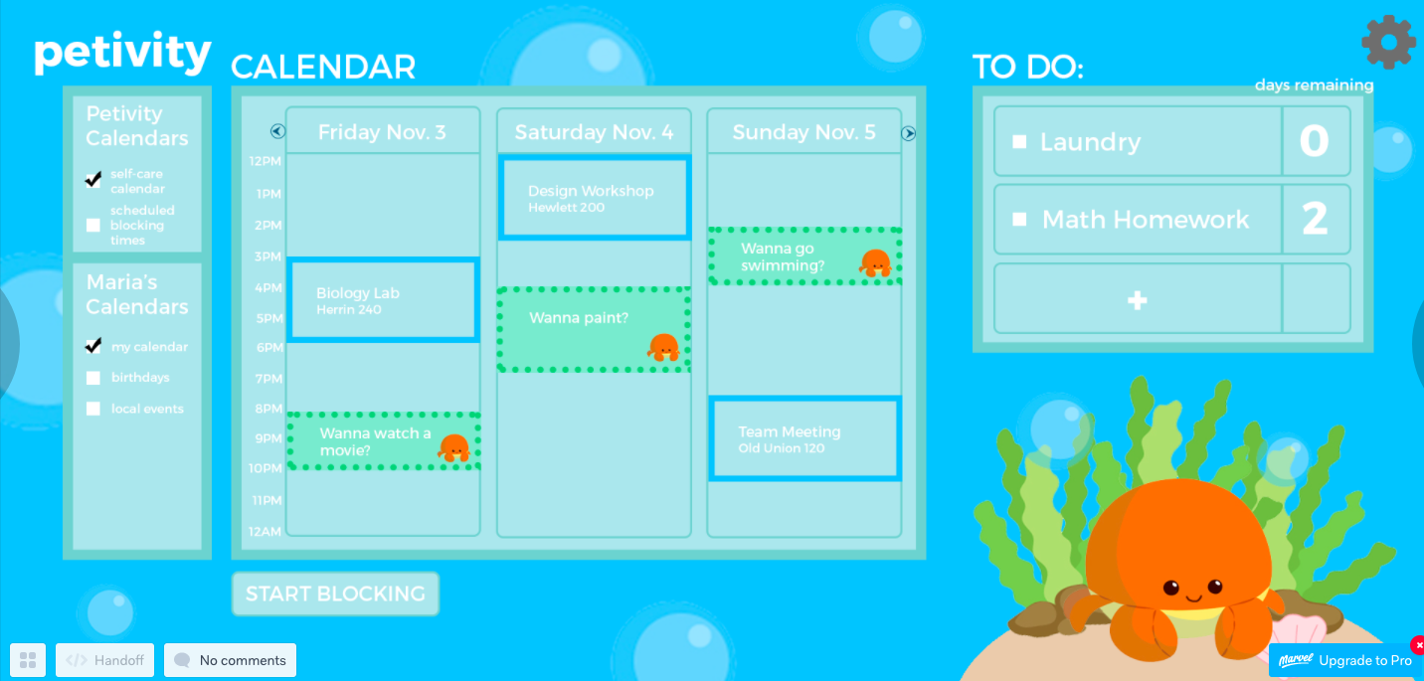
Main Page
Click on self-care calendar and it should appear
Click on “wanna go swimming?”
TASK 3: Web

Slide 38
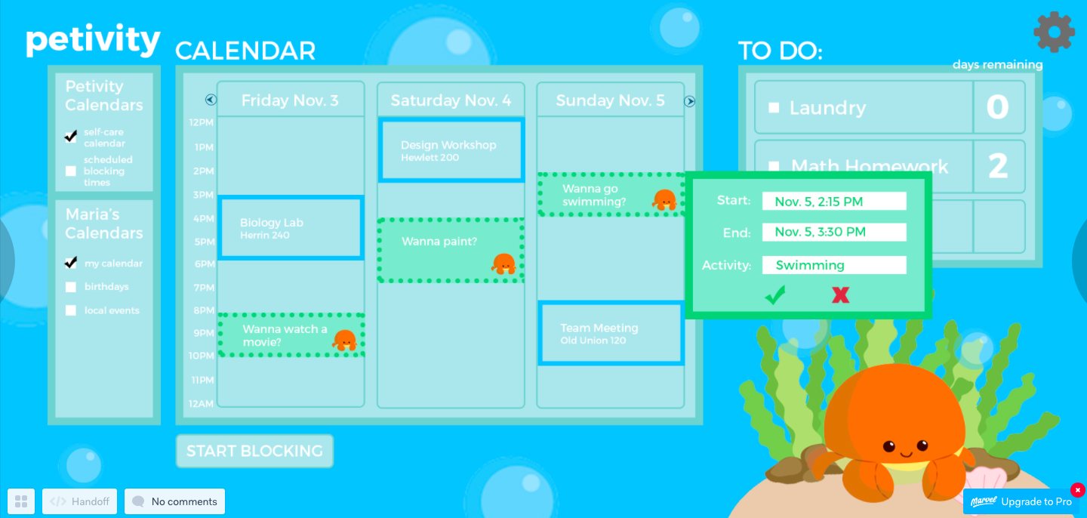
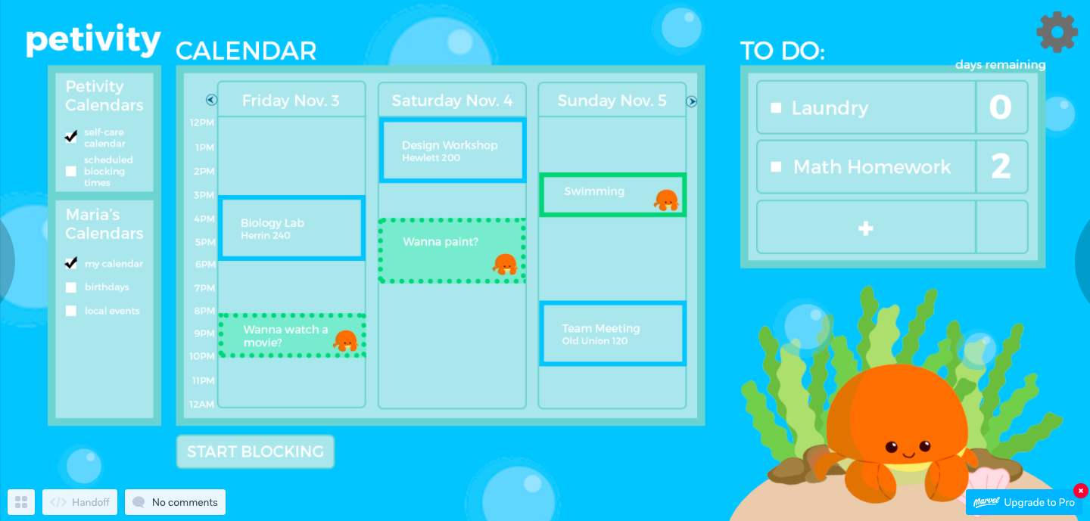
Timer starts automatically
Click buttons to navigate
Click confirm
TASK 3
Web
Click on page
Clicks on restart
Adds self care item to the calendar
TASK 3: Web

Slide 39
Timer starts automatically
Click buttons to navigate
Click self-care calendar
TASK 3
Web
Click on page
Clicks on restart
Main Calendar should display schedule self-care activity now
TASK 3: Web

Slide 40
4.
Prototype overview

Slide 41
PROTOTYPING TOOLS
We used:
Photoshop
Marvel
How the Tools Helped:
Helped create the visuals for the prototype
Helped mimic how the user would interact with the tool - used as emulator for Android and laptop/desktop view
How the Tools Didn’t Help:
Could not create the full breadth of options
Could not do actions like swipe/scroll
Could not use actually user-typed input

Slide 42
Limitations/trade offs of the current prototype
We turned all interactions into click interactions for both web and mobile to simplify interactions and implementation in Marvel
To simplify and focus on our main task flows, we did not include:
In Mobile: Pages for personalizing the pet, pet store, profile, settings, link account to social media, inventory, accounts, etc.
In Web: the ability to toggle the calendar view scope, additional ways of input, animations and more interactiveness with pet, etc.

Slide 43
Wizard of Oz Techniques
On Mobile:
The time changing as if time was passing for the block time when blocking was activated
On Web:
Self-care suggestions automatically appear once self-care calendar is chosen. It is simulating the fact that self-care suggestions would be optimized with AI based on time available, interests, past selections, etc. to offer the 3 optimal selections for user.
After clicking start blocking, user is automatically brought to the blocked social media site to see what the site would look like. Then, user clicks to get out. In real world, the user would be shown the blocked page only after navigating to the site normally.

Slide 44
Hard-coded Features and Why Required:
On mobile, we hard-coded:
Textual content for the usual profile during sign-up and login
The food quantity/type icon since the amount would be what is accumulated in the web account
On web, we hard-coded:
Textual content for the pop-up boxes and any input field
Why required? - Since it’s not possible/too complicated to track user text input for prototype in Marvel, we resorted to hard-coding. Furthermore, we hard-coded the amount of food items because that would normally sync with user account and since we have a fictional user, there’s no actual account to sync.

Slide 45

Thank You!
Any Questions?

